Slide 1
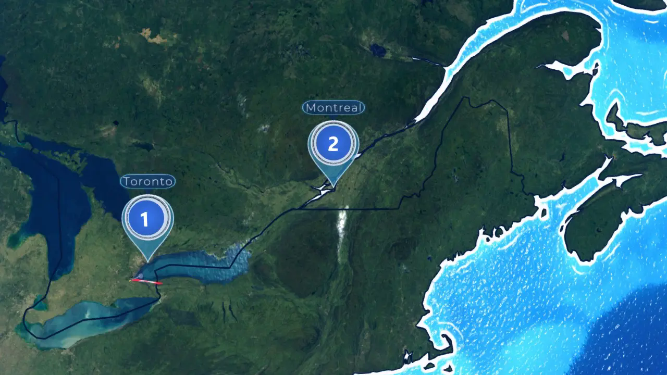
Animate a route on one PowerPoint slide
Illustrative city-to-city movement, not a road trace
Notes:
Source and reuse notes — AlbumMap one-slide route example
Source lineage checked 25 October 2026. Original native animation tested 24 October 2026 in PowerPoint for Windows Version 2609.
The background is an FFmpeg conversion of quiz-reveal-montreal.webp, extracted at 10 seconds from the original 21-second local city-locator map render. The Toronto and Quebec City quiz frames use 2 and 18 seconds. These are approximate city locators, with no census population panels.
The editable yellow ellipse and its four-second custom motion path were added in PowerPoint. The silent MP4 and poster are from that original native export. The background labels, numbered pins and small country flags are part of a fixed image. The marker illustrates a connection between cities; it does not follow a road or a recorded track.
AlbumMap, 2026. Geographic renderer adapted from Geographical Adventures by Sebastian Lague, using the named imagery and data sources.
The named quiz map pictures, this one-slide example and its named MP4/poster: Creative Commons Attribution-ShareAlike 2.5 Generic. https://creativecommons.org/licenses/by-sa/2.5/
Keep the creators, source links, licence and change notes with copies. Identify your changes and follow the applicable ShareAlike terms. Public-domain inputs retain their status. The separate data-source notices and other rights remain applicable; no upstream endorsement is implied.
This notice does not license Microsoft software, renderer software, source fonts, article text, quiz HTML/JavaScript, hosted exports or other user media. No endorsement by the named source organizations is implied.
Renderer foundation: Sebastian Lague and Geographical Adventures contributors
https://github.com/SebLague/Geographical-Adventures
MIT software licence; Copyright (c) 2024 Sebastian Lague
https://github.com/SebLague/Geographical-Adventures/blob/main/LICENSE
Local map-video recorder and editorial sequence. The software licence is distinct from the source-data licences. No Unity project or software binary is included in this pack.
Land colour and terrain: NASA Visible Earth / NASA Earth Observatory
https://visibleearth.nasa.gov/images/73934/topography
https://science.nasa.gov/earth/earth-observatory/blue-marble-next-generation/topography-bathymetry-maps/
NASA media usage guidelines; source credit retained
https://www.nasa.gov/nasa-brand-center/images-and-media/
The upstream renderer maps colour textures onto a globe and modifies terrain height, including reducing some small-island heights. Camera, shading and rendering further transform the display.
The upstream project credits NASA for land colour and topography. Its height-source note names this collection. An exact observation date or edition for each local texture is not supplied, and no current satellite view is claimed.
City-light texture: NASA Earth Observatory
https://earthobservatory.nasa.gov/features/NightLights
https://www.nasa.gov/nasa-brand-center/images-and-media/
Declared in the upstream credit menu and local source note; the actual texture is bound in the terrain material. The old article URL now redirects to the general Earth Observatory section, so it does not establish a specific dataset edition. The example uses always-daylight framing.
Country shapes and city-location data: Natural Earth contributors
https://www.naturalearthdata.com/
Public domain
https://www.naturalearthdata.com/about/terms-of-use/
Geographic information is incorporated into the globe renderer. The quiz pictures show approximate Toronto, Montreal and Quebec City centres. The PowerPoint background uses the Montreal reveal frame; it is not a landmark pin, road trace or measured journey.
Country flag pictures: Flagpedia.net / Wikimedia Commons contributors
https://flagpedia.net/download
Flagpedia public-domain download terms
https://flagpedia.net/download
Flags are drawn as small map labels. They do not indicate endorsement or any travel authorization.
Star field: David Nash / Astronomy Nexus
HYG star database, version 3 family
https://github.com/astronexus/HYG-Database
Creative Commons Attribution-ShareAlike 2.5 Generic
https://creativecommons.org/licenses/by-sa/2.5/
https://github.com/astronexus/HYG-Database/blob/main/hyg/README.md
The renderer omits the Sun, selects 8,912 stars of magnitude at most 6.5, converts right ascension and declination to directions, normalizes brightness and applies a colour gradient. The visible star field is a rendered adaptation.
Version-specific terms for HYG 2.x/3.x are used. The repository current-version 4.0 licence is not substituted for the local version 3 data.
Rendered city-label lettering: The Montserrat.Git Project Authors
https://github.com/JulietaUla/Montserrat
SIL Open Font License 1.1
https://openfontlicense.org/
City names are rasterized into the map image. No font file is included.
Numbered marker lettering: Microsoft Arial and Segoe UI
https://learn.microsoft.com/en-us/typography/fonts/font-faq
The numbered map badges are rasterized on Windows. The slide title, caption and yellow marker remain native PowerPoint objects. Arial is referenced by name; no font file is embedded or distributed.

